Slide 1
Algorithms: Dynamic Programming
Computer Science, Purdue University

Slide 2
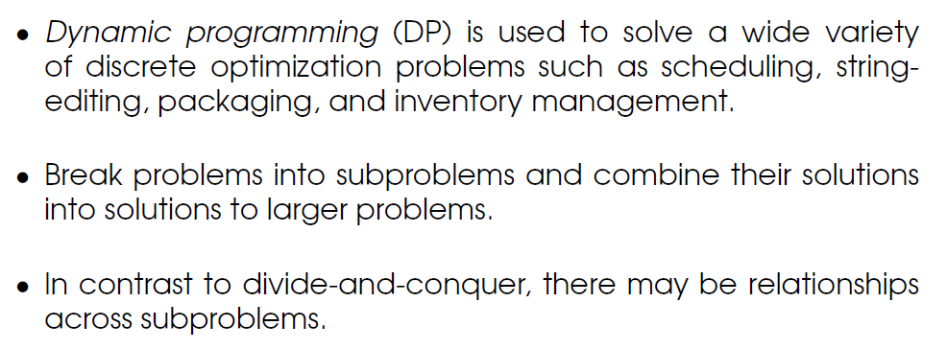
Algorithms: Dynamic Programming
Dynamic Programming Algorithms
Computer Science, Purdue University

Slide 3
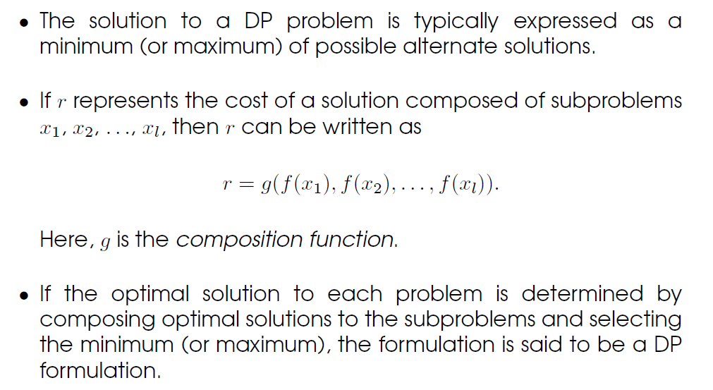
Algorithms: Dynamic Programming
Dynamic Programming Algorithms
Computer Science, Purdue University

Slide 4
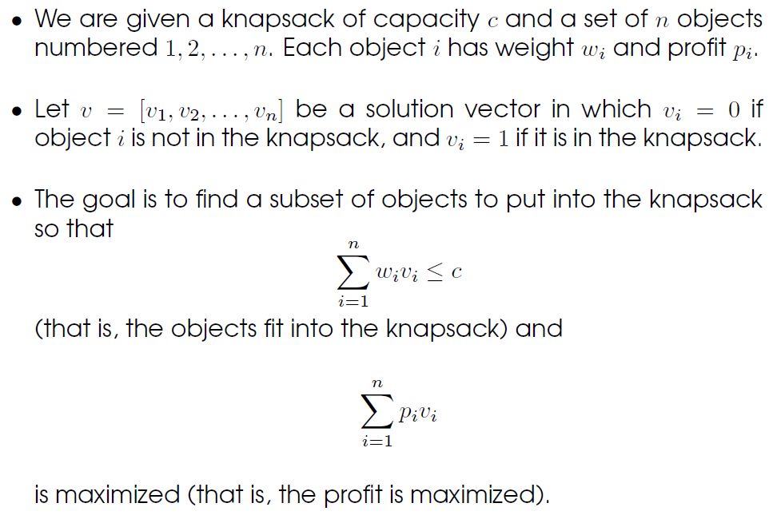
Algorithms: Dynamic Programming
0/1 Knapsack Problem
Computer Science, Purdue University

Slide 5
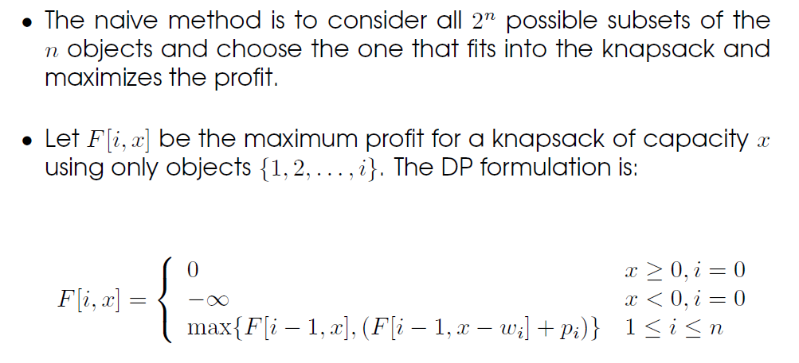
Algorithms: Dynamic Programming
0/1 Knapsack Problem
Computer Science, Purdue University

Slide 6
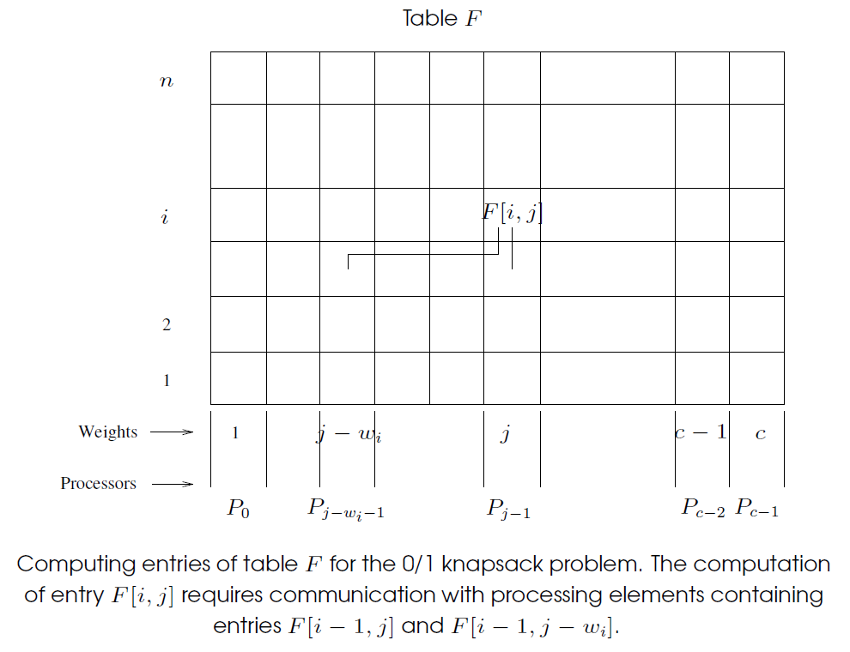
Algorithms: Dynamic Programming
0/1 Knapsack Problem
Computer Science, Purdue University

Slide 7
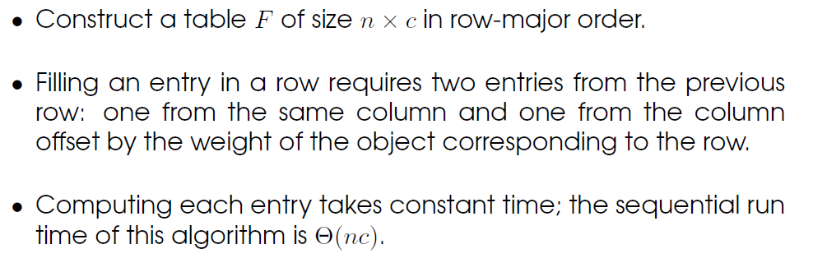
Algorithms: Dynamic Programming
0/1 Knapsack Problem
Computer Science, Purdue University

Slide 8
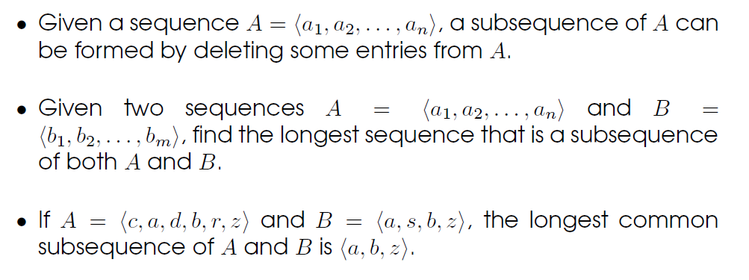
Algorithms: Dynamic Programming
Longest Common Subsequence Problem
Computer Science, Purdue University

Slide 9
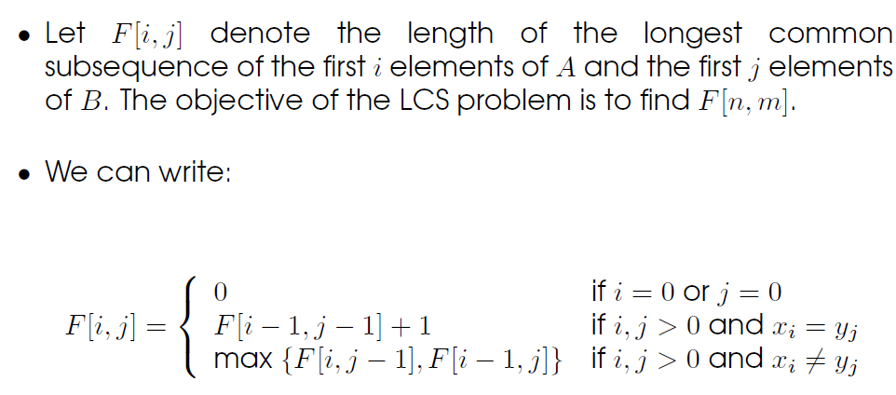
Algorithms: Dynamic Programming
Longest Common Subsequence Problem
Computer Science, Purdue University

Slide 10
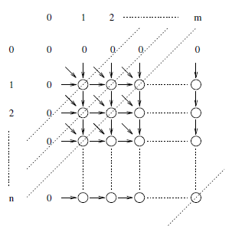
Algorithms: Dynamic Programming
Longest Common Subsequence Problem
Computing entries of table F for the
longest-common-subsequence problem. Computation proceeds along the dotted diagonal lines.
Computer Science, Purdue University

Slide 11
Algorithms: Dynamic Programming
Longest Common Subsequence Problem
The algorithm computes the two-dimensional F table in a row or column-major fashion. The complexity is (nm), where the lengths of the two input strings are n and m.
Computer Science, Purdue University

Slide 12
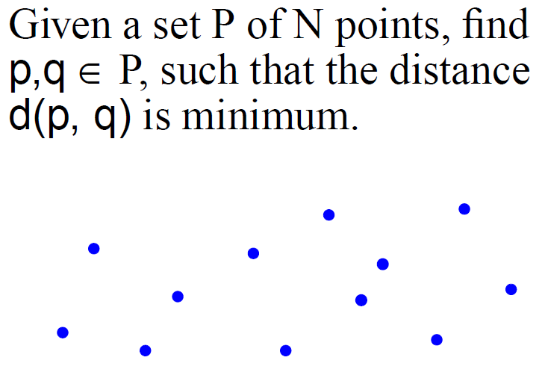
Algorithms: Divide and Conquer Algorithms
Closest Pair Problem
Computer Science, Purdue University

Slide 13
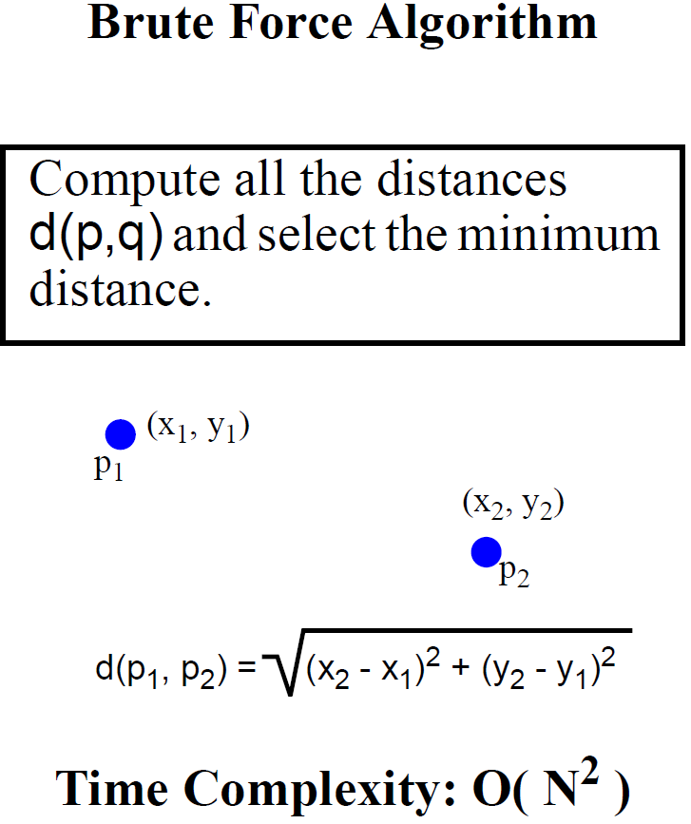
Algorithms: Divide and Conquer Algorithms
Closest Pair Problem
Computer Science, Purdue University

Slide 14
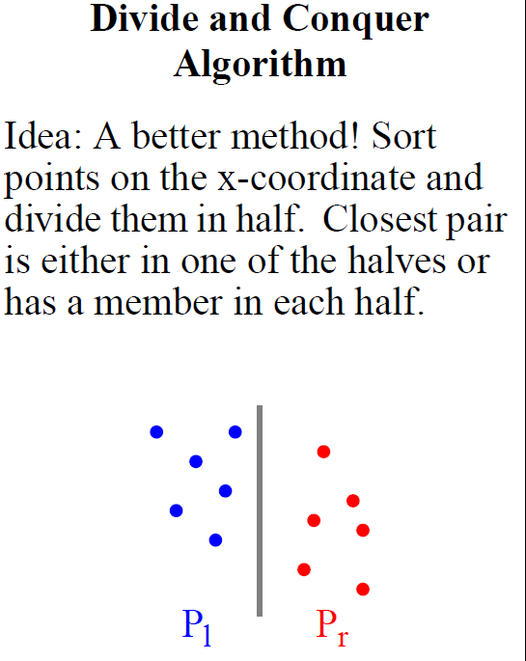
Algorithms: Divide and Conquer Algorithms
Closest Pair Problem
Computer Science, Purdue University

Slide 15
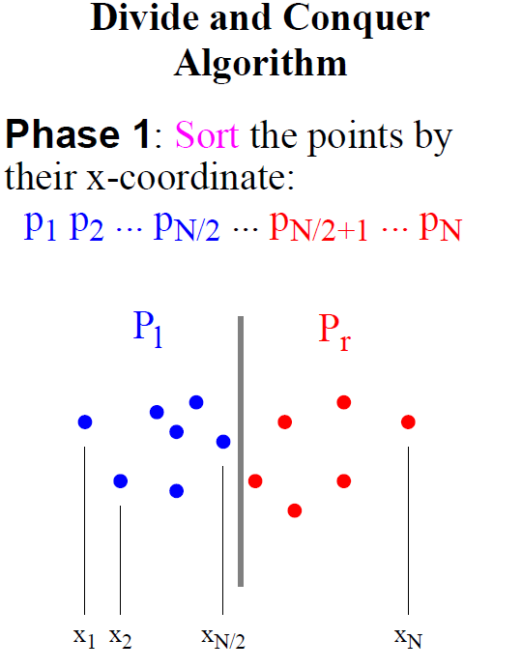
Algorithms: Divide and Conquer Algorithms
Closest Pair Problem
Computer Science, Purdue University

Slide 16
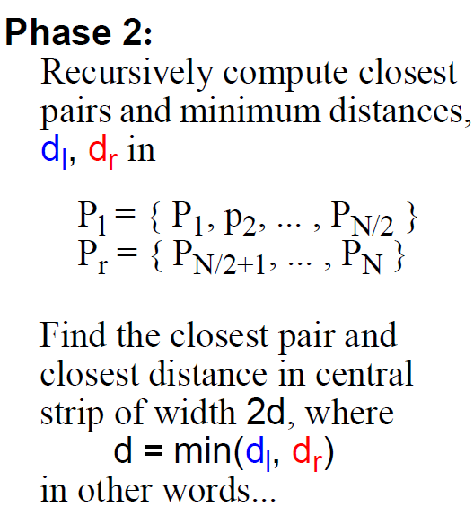
Algorithms: Divide and Conquer Algorithms
Closest Pair Problem
Computer Science, Purdue University

Slide 17
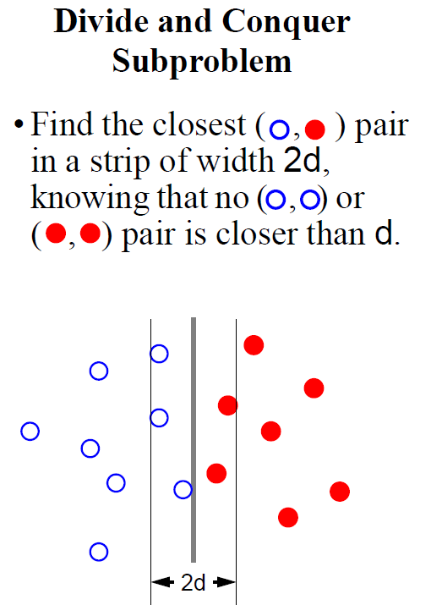
Algorithms: Divide and Conquer Algorithms
Closest Pair Problem
Computer Science, Purdue University

Slide 18
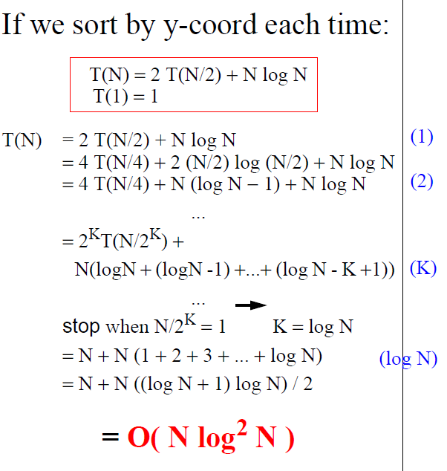
Algorithms: Divide and Conquer Algorithms
Closest Pair Problem
Computer Science, Purdue University

Slide 19
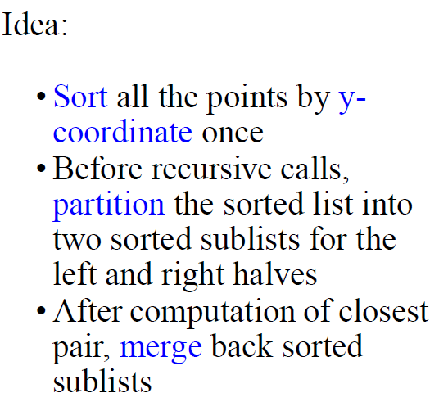
Algorithms: Divide and Conquer Algorithms
Closest Pair Problem
Computer Science, Purdue University

Slide 20
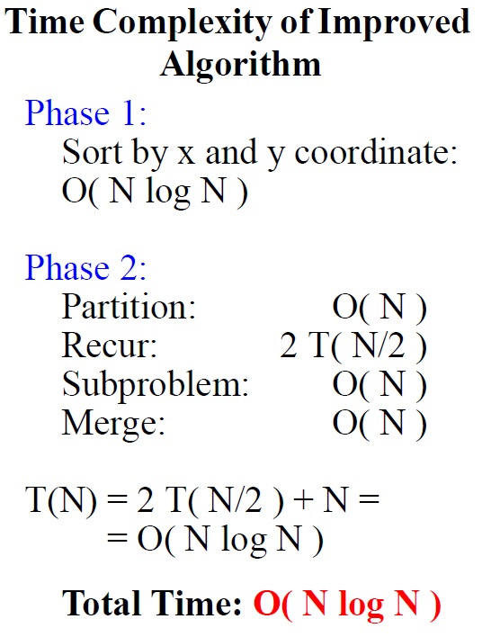
Algorithms: Divide and Conquer Algorithms
Closest Pair Problem
Computer Science, Purdue University

Slide 21
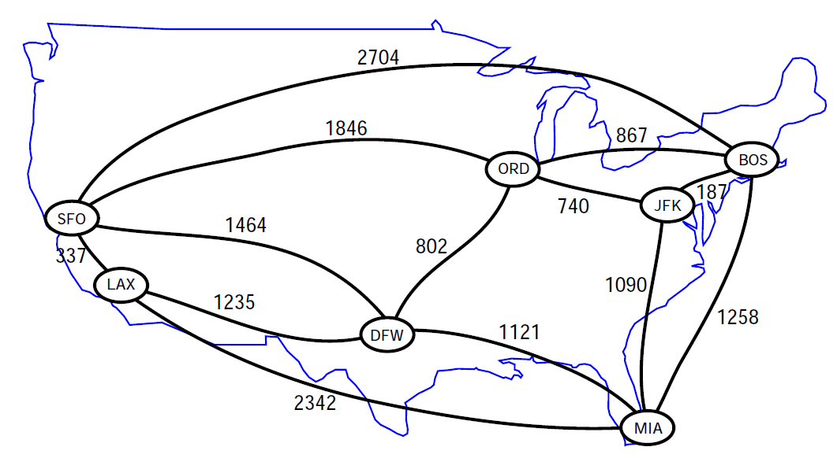
Algorithms: Greedy Algorithms
Shortest Paths in Graphs
Computer Science, Purdue University

Slide 22
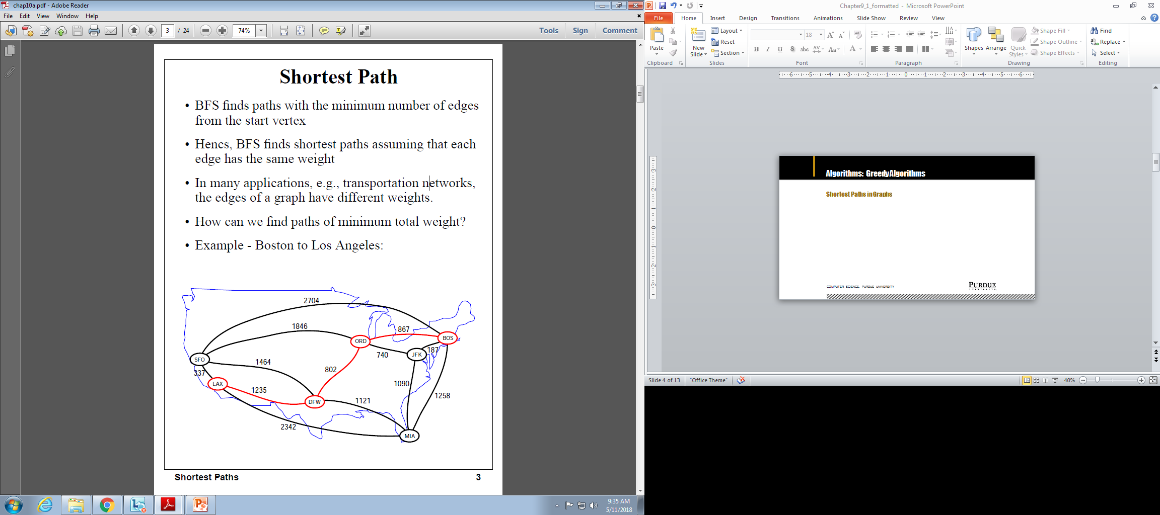
Algorithms: Greedy Algorithms
Shortest Paths in Graphs
Computer Science, Purdue University

Slide 23
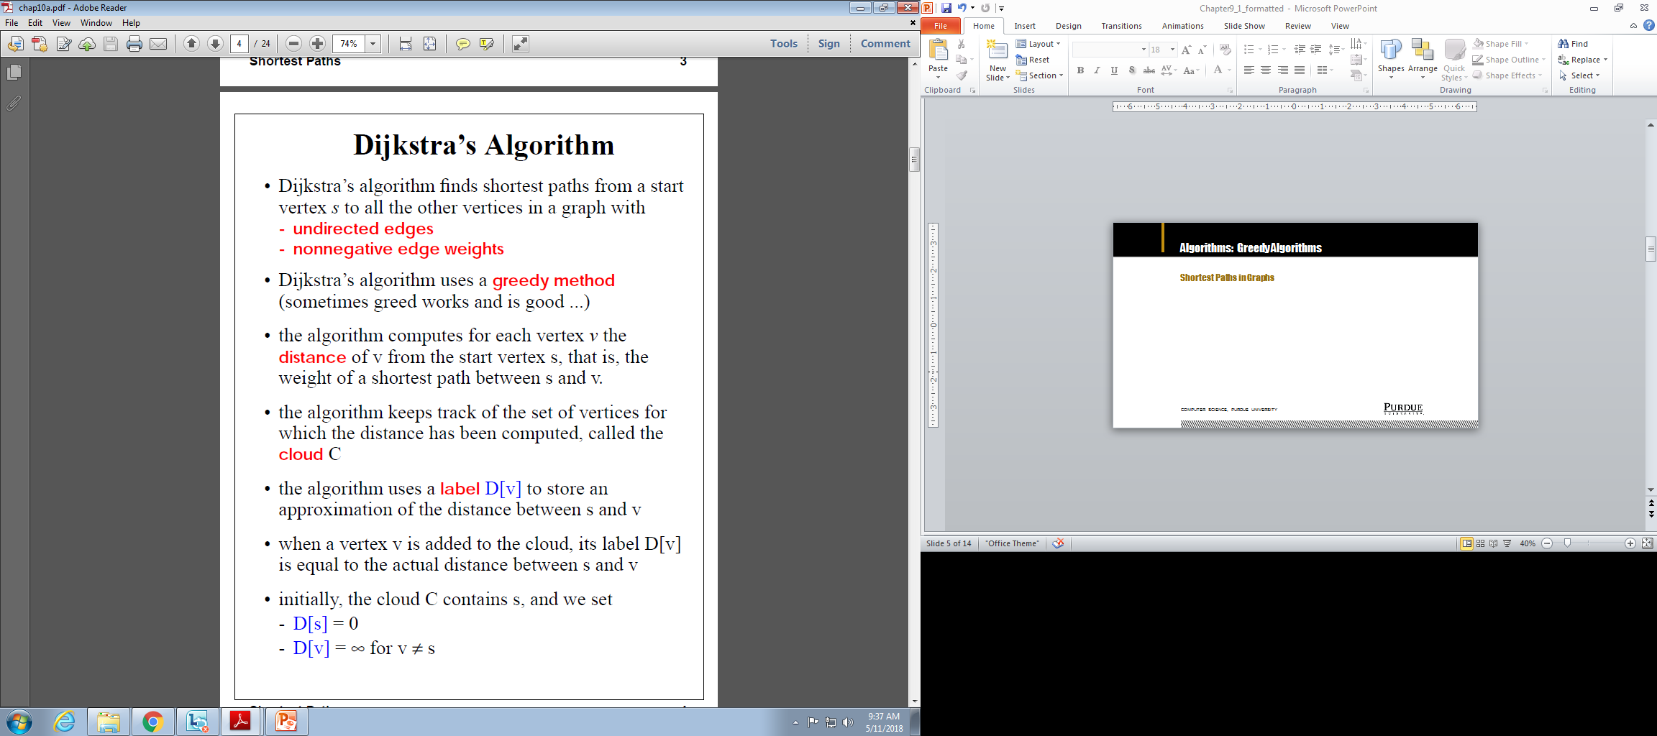
Algorithms: Greedy Algorithms
Shortest Paths in Graphs
Computer Science, Purdue University

Slide 24
Algorithms: Greedy Algorithms
Shortest Paths in Graphs: Dijkstra’s Algorithm
Computer Science, Purdue University

Slide 25
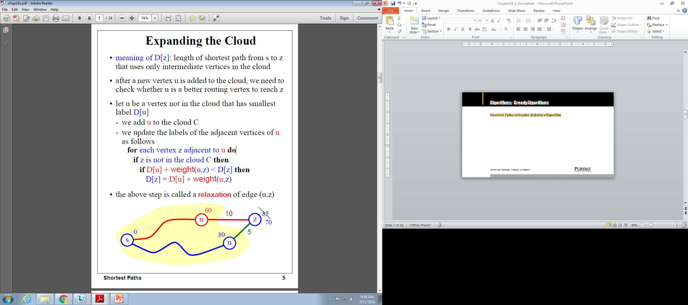
Algorithms: Greedy Algorithms
Shortest Paths in Graphs: Dijkstra’s Algorithm
Computer Science, Purdue University

Slide 26
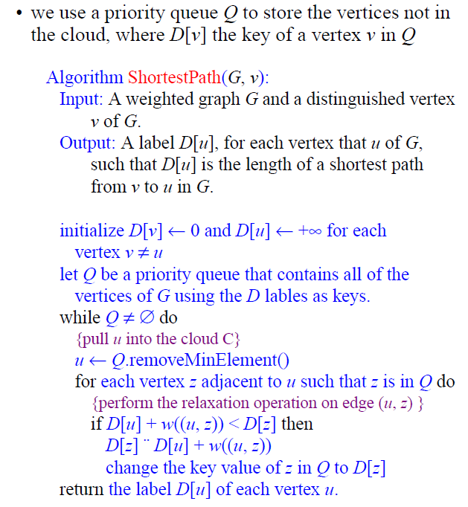
Algorithms: Greedy Algorithms
Shortest Paths in Graphs:
Dijkstra’s Algorithm
Computer Science, Purdue University

Slide 27
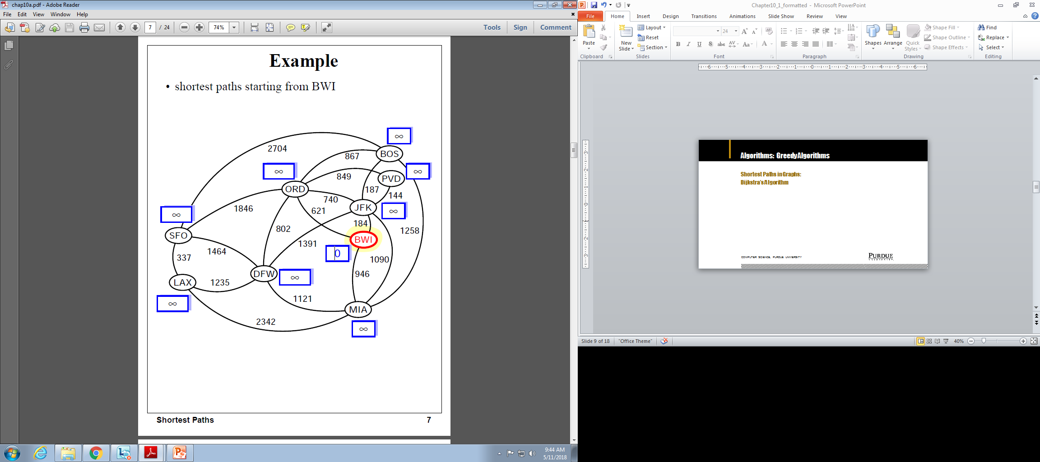
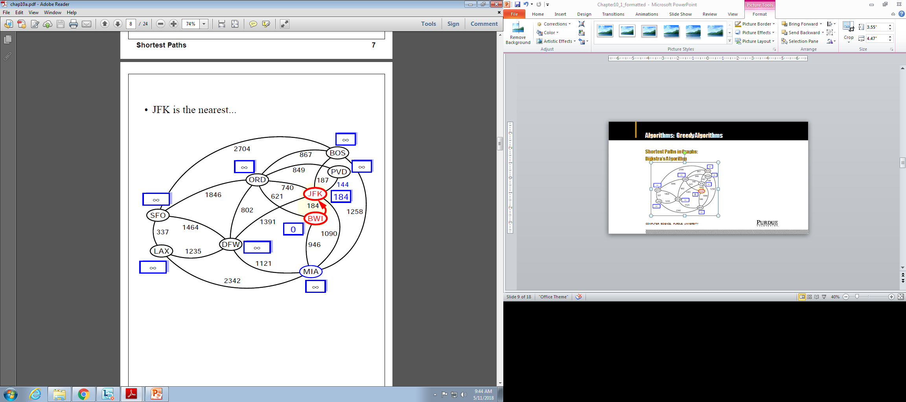
Algorithms: Greedy Algorithms
Shortest Paths in Graphs:
Dijkstra’s Algorithm
Computer Science, Purdue University

Slide 28
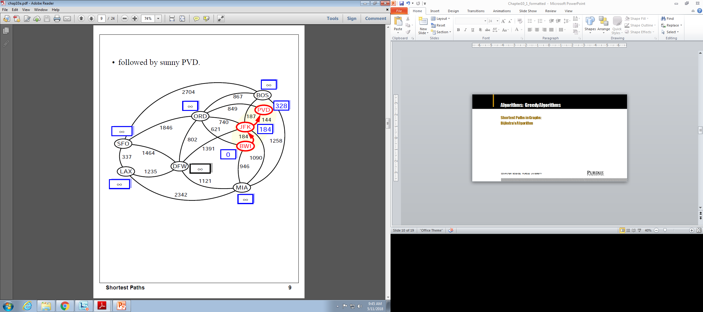
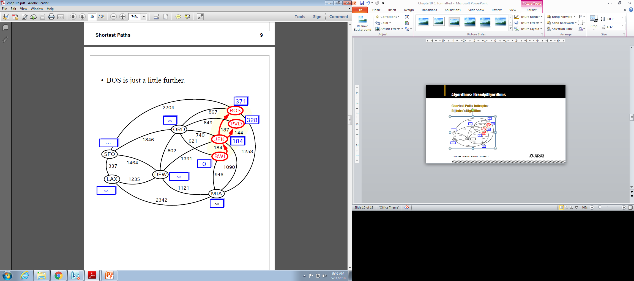
Algorithms: Greedy Algorithms
Shortest Paths in Graphs:
Dijkstra’s Algorithm
Computer Science, Purdue University

Slide 29
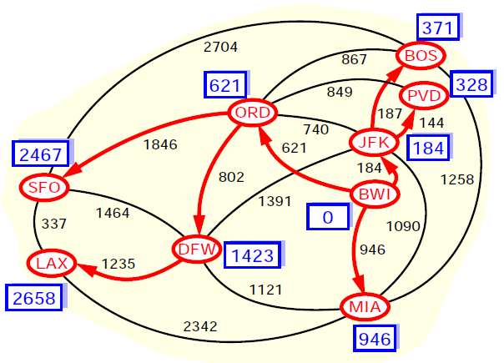
Algorithms: Greedy Algorithms
Shortest Paths in Graphs:
Dijkstra’s Algorithm
Computer Science, Purdue University

Slide 30
Algorithms: Greedy Algorithms
Shortest Paths in Graphs:
Dijkstra’s Algorithm
Computer Science, Purdue University

Slide 31
Algorithms: Greedy Algorithms
Shortest Paths in Graphs: Dijkstra’s Algorithm
Running Time
Let’s assume that we represent G with an adjacency list. We can then step through all the vertices adjacent to u in time proportional to their number (i.e. O(j) where j in the number of vertices adjacent to u)
The priority queue Q:
A Heap: Implementing Q with a heap allows for efficient extraction of vertices with the smallest D label(O(log N)). If Q is implemented with locators, key updates can be performed in O(log N) time. The total run time is O((n+m)log n) where n is the number of vertices in G and m in the number of edges. In terms of n, worst case time is O(n²log n)
Unsorted Sequence: O(n) when we extract minimum elements, but fast key updates (O(1)). There are only n-1 extractions and m relaxations. The running time is O(n²+m)
Computer Science, Purdue University

Slide 32
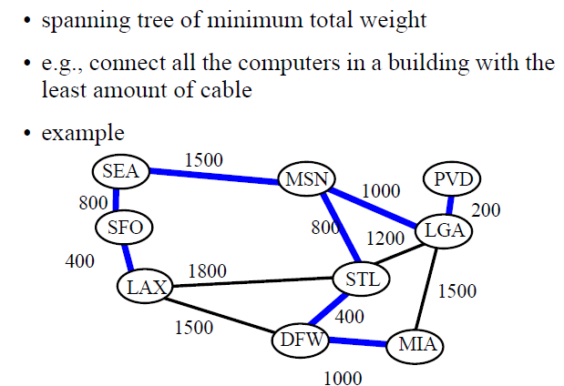
Algorithms: Greedy Algorithms
Minimum Spanning Tree
Computer Science, Purdue University

Slide 33
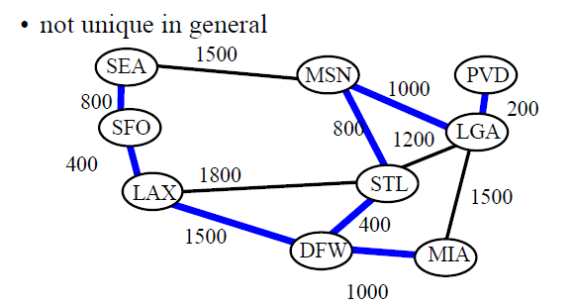
Algorithms: Greedy Algorithms
Minimum Spanning Tree
Computer Science, Purdue University

Slide 34
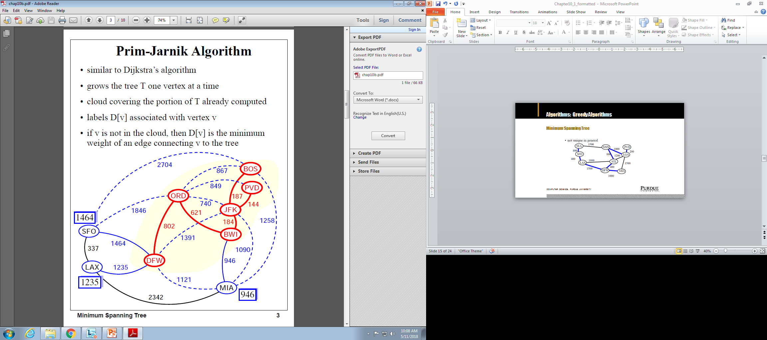
Algorithms: Greedy Algorithms
Minimum Spanning Tree
Computer Science, Purdue University

Slide 35
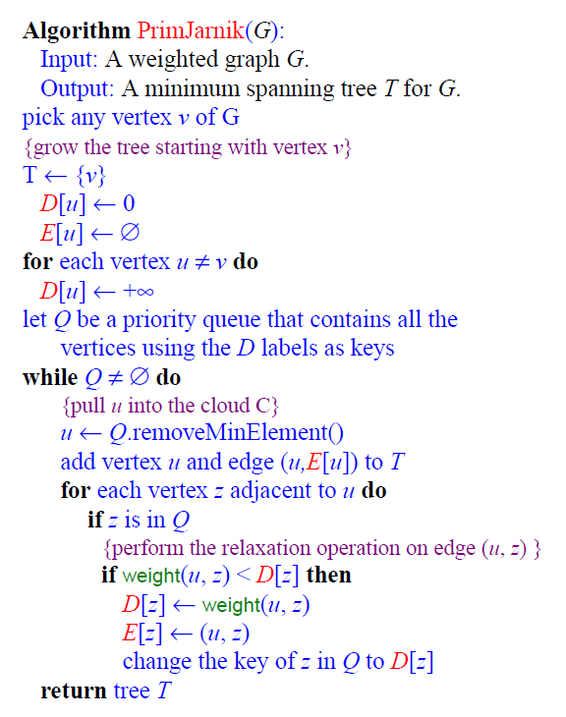
Algorithms: Greedy Algorithms
Minimum Spanning Tree:
Prim-Jarnik Algorithm
Runtime is same as the shortest path algorithms
Computer Science, Purdue University

Slide 36
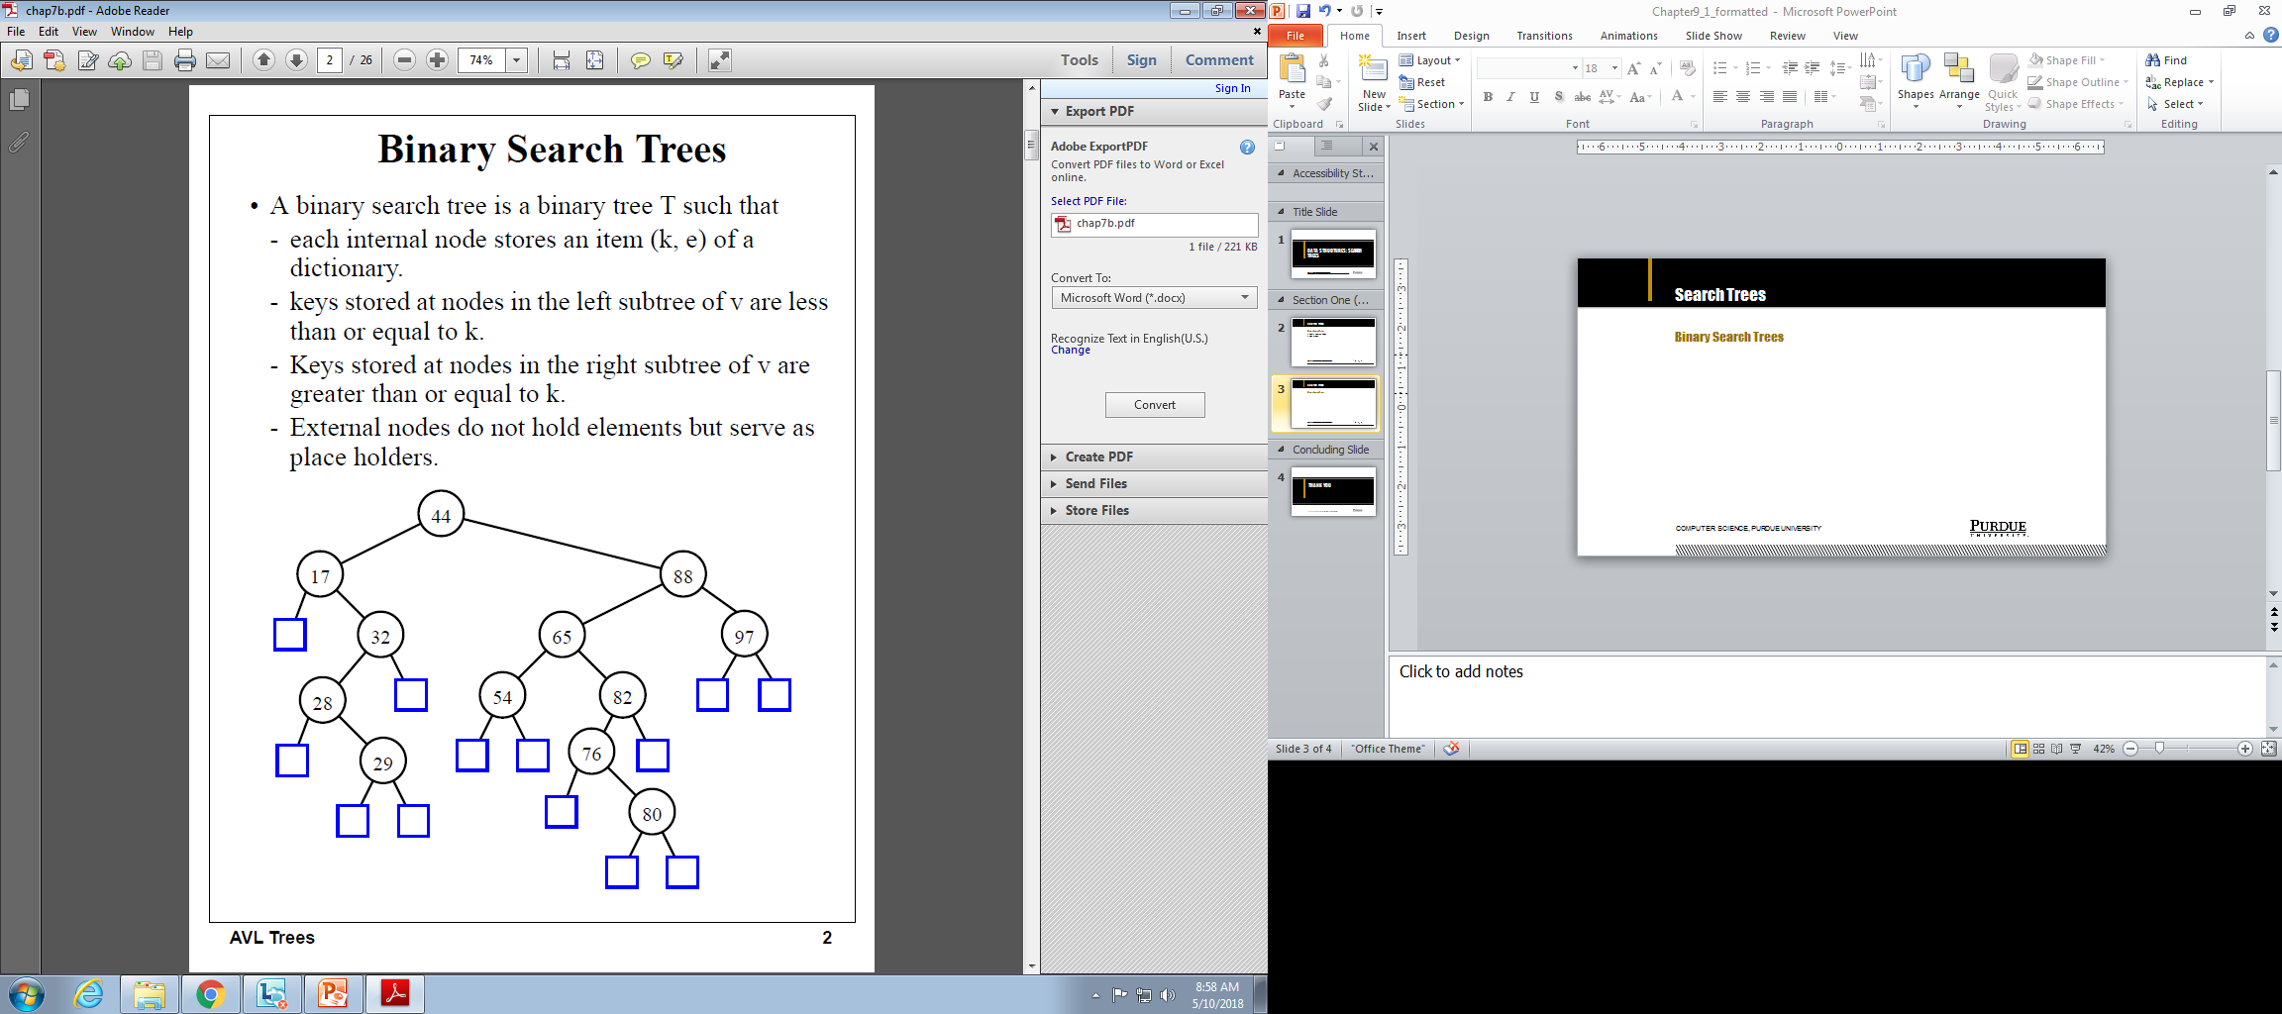
Search Trees
Binary Search Trees
Computer Science, Purdue University

Slide 37
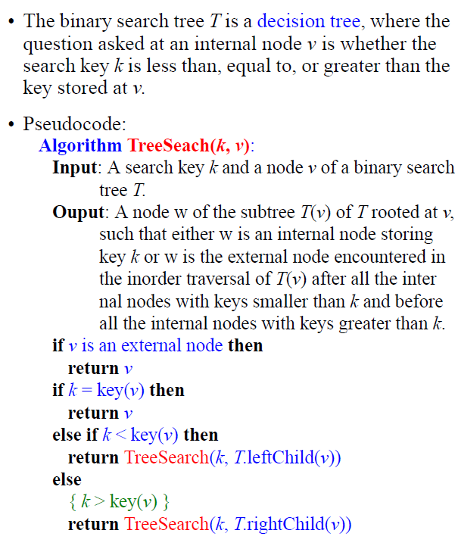
Search Trees
Binary Search Trees
Computer Science, Purdue University

Slide 38
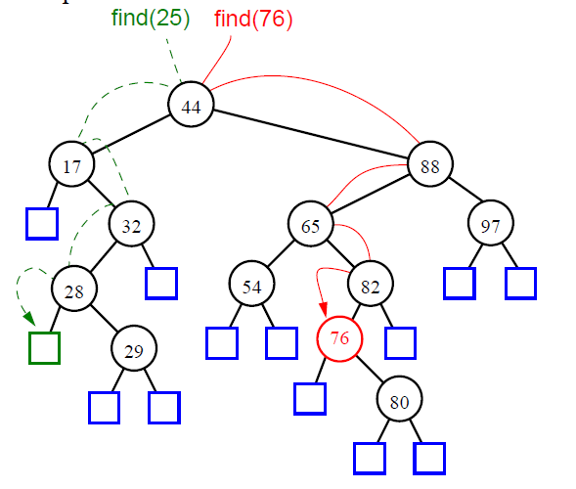
Search Trees
Binary Search Trees
Computer Science, Purdue University

Slide 39
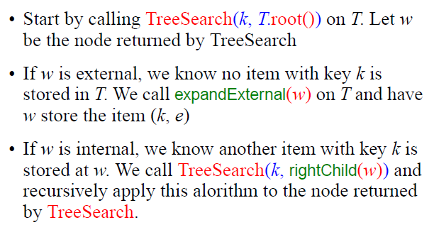
Search Trees
Binary Search Trees:
Insertion
Computer Science, Purdue University

Slide 40
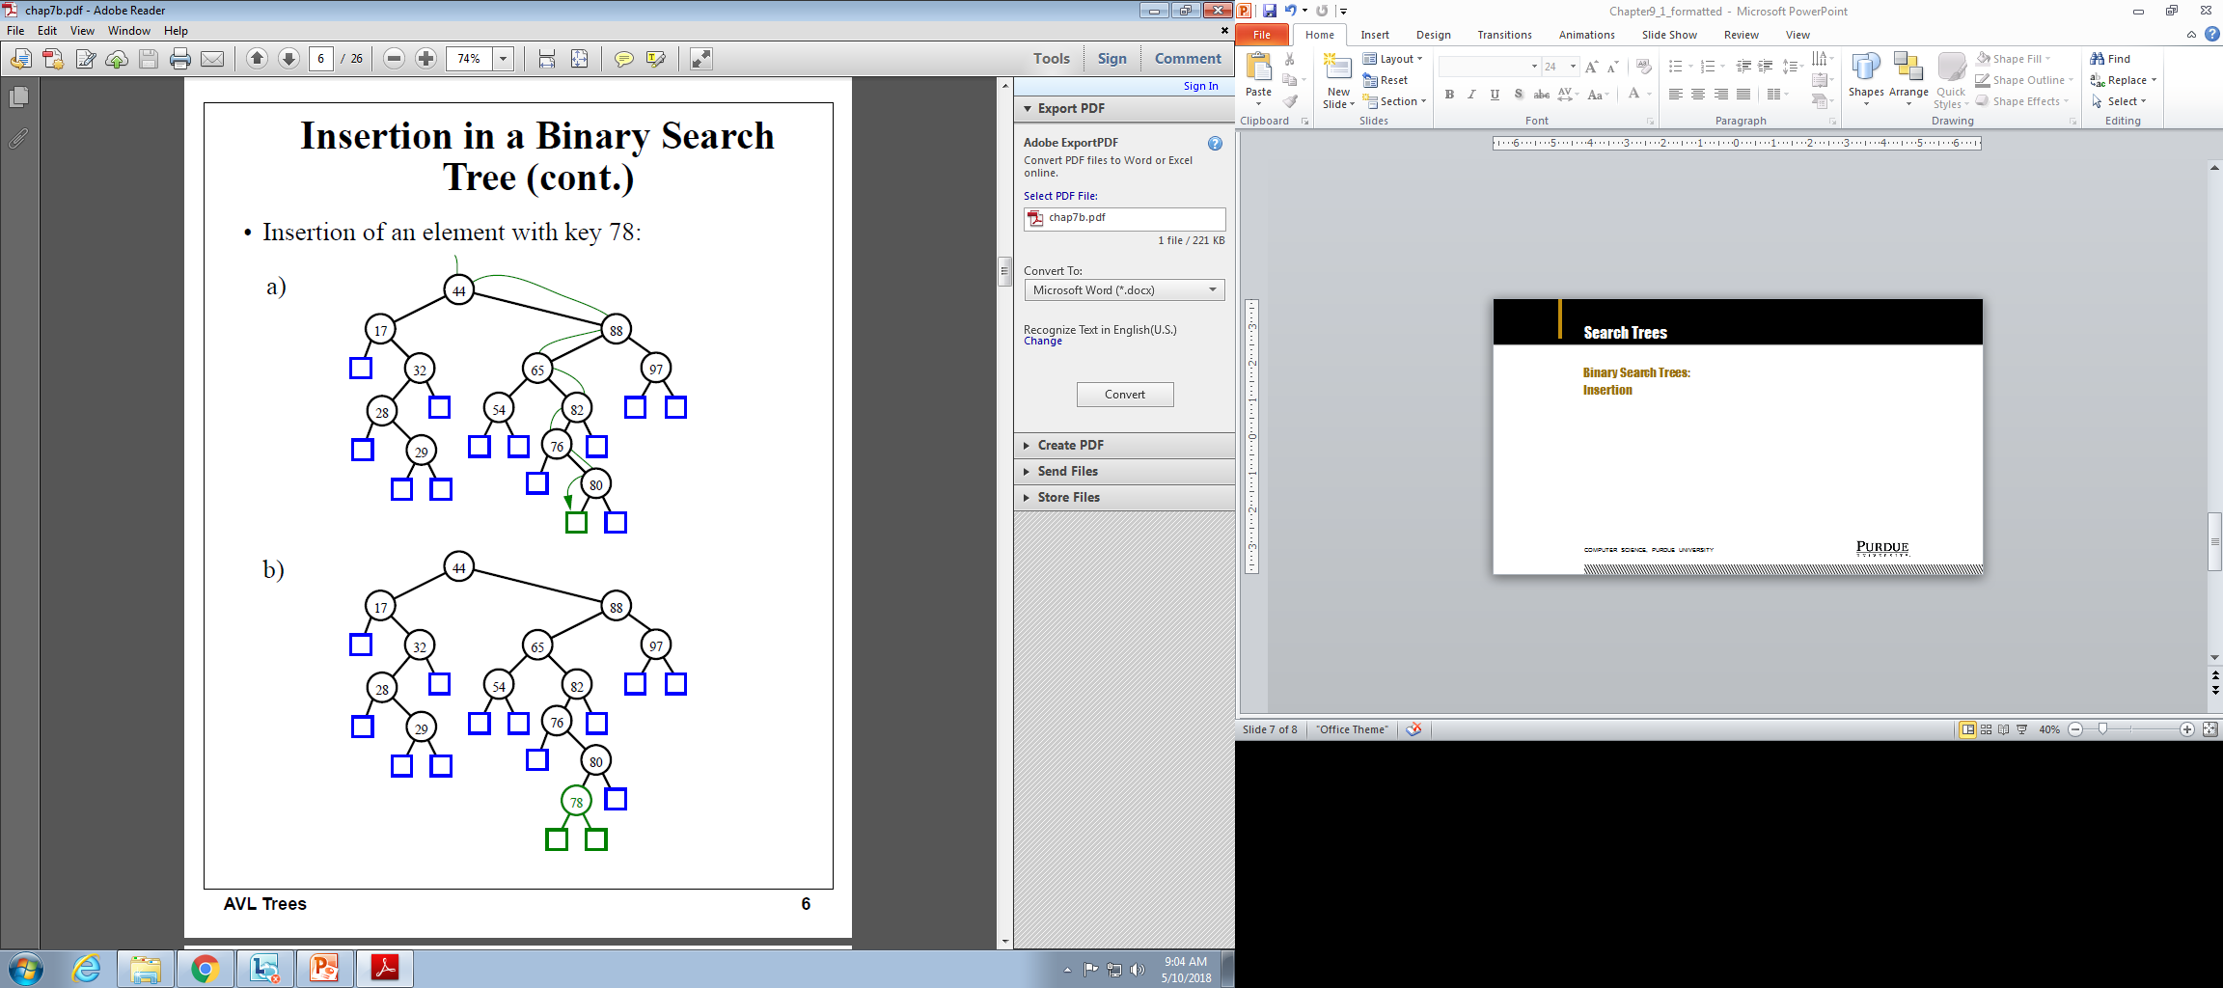
Search Trees
Binary Search Trees:
Insertion
Computer Science, Purdue University

Slide 41
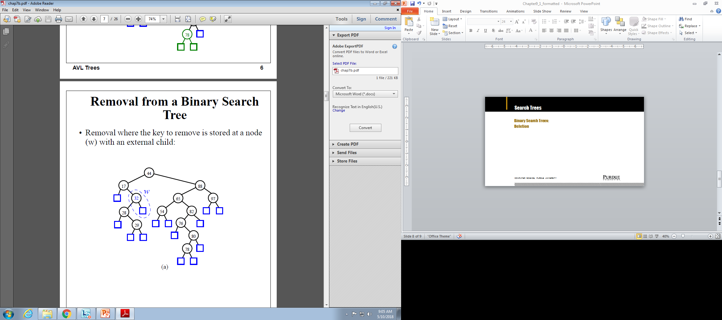

Search Trees
Binary Search Trees:
Deletion
Computer Science, Purdue University

Slide 42
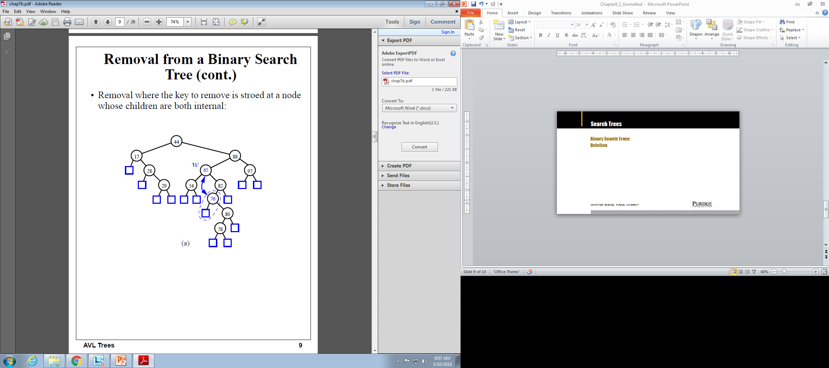
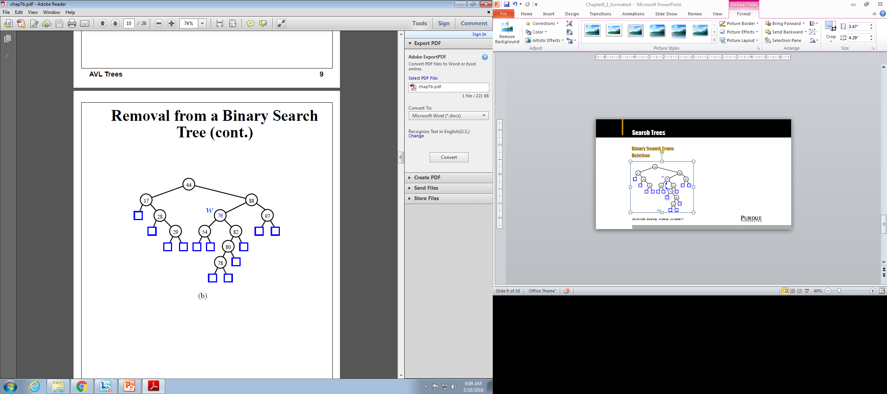
Search Trees
Binary Search Trees:
Deletion
Computer Science, Purdue University

Slide 43

Search Trees
Binary Search Trees: Time Complexity
Computer Science, Purdue University

Slide 44
Thank You

